Slide 1
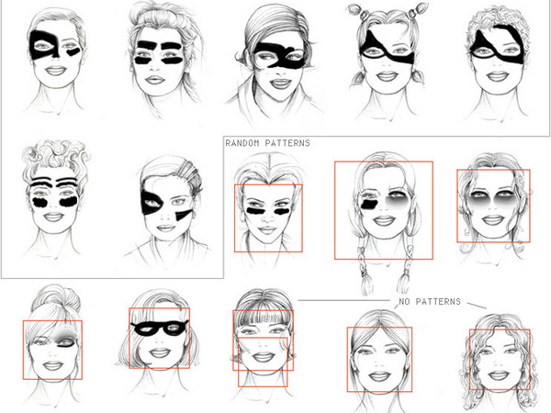
Values in design CSCI 5839 Fall 2014
Values in design
CSCI 3002 Fall 2018
Anti-facial-recognition makeup by Pepin Press.
http://animalnewyork.com/wp-content/uploads/2010/04/asbtract_makeup.jpg
Notes:
Anti-face recognition makeup by Pepin Press.
http://animalnewyork.com/wp-content/uploads/2010/04/asbtract_makeup.jpg

Slide 2
Tomorrow
Project storyboards
Bring a storyboard

Slide 3
Today
Understanding values in design

Slide 4
The big idea
Technology has the potential to support or undermine values
Technology can be biased
Features of the designed artifact can impact values
Features of the design process itself can also impact values

Slide 5
What is a value?
In a narrow sense, the word “value” refers simply to the economic worth of an object. For example, the value of a computer could be said to be two thousand dollars. However, in the work described here, we use a broader meaning of the term wherein a value refers to what a person or group of people consider important in life.
Friedman, Kahn, and Borning. Value Sensitive Design and Information Systems

Slide 6
Understanding values by example
What are the values that guide how we typically design systems?
In other words, what are the things that we (in the world) tend to value when designing technology?
Right now, don’t worry about our (enlightened) perspective - what do regular people think?
Talk with your neighbor

Slide 7
Traditional values in software systems
Making money / success
Usability
Impact
Social advancement
Cool
Convenience
Security
Participation

Slide 8
Commonly-considered values
System characteristics: Price, performance, development time, reliability, security
Access and availability: open source (and intellectual property), affordability, accessibility, transparency
Impacts on people: usability, privacy, safety, fun
Notes:
These are just values too. Are they important?

Slide 9
Another perspective on values
Does the system express “should” statements about how it should be used?
Example: consider a chat client targeted at teenagers
Should parents be able to see their children’s messages? We may have multiple perspectives:
Yes, they should
No, they should not
It is up to the parent to decide
It is up to the child to decide
It should be negotiated between parent and child
Notes:
Each perspective can result in a different system design
Who gets to decide? Approve or disapprove?

Slide 10
Uh oh, this is getting political…
Part of considering the role of values in design is recognizing that people’s values differ, and that’s OK
We almost certainly have some shared values: equality, fairness, democracy
Some values may differ based on the community and individual
Sometimes we may explicitly aim to influence values

Slide 11
How does this affect us?
Computer scientists can have impact. The kinds of systems we develop can influence individuals and society
Being aware of these issues can increase your ability to predict and influence the outcomes of what you make
Technology that doesn’t match the user group’s values may be rejected (or undermined)
Now that you are aware, consider your own responsibility in influencing the values expressed by things that you make…
Notes:
Examples: Google Glass? Surveillance tech

Slide 12
Setting expectations re: values
That designers and developers consider how their work may impact values before putting their work out into the world
Considering the values of the designer themselves, the organization producing the work, the user group (including minority voices)
That we make intentional decisions about values rather than sidestepping responsibility

Slide 13
Key question
Does technology itself have values, or is it value neutral?
Discuss with your neighbor; come up with examples (we’ll all be extra careful to respect divergent opinions here)

Slide 14
Technology is value neutral…

Slide 15
Technology is NOT value neutral…

Slide 16
Is there a correct answer to this question?
… probably not?
Ultimately you can have either perspective (technology itself expresses values; technology is value-neutral but can be used to support or undermine values)
However, most people would agree that technology can impact values
Notes:
we can leave it to the philosophers

Slide 17
Value Sensitive Design
Design approach popularized by Prof. Batya Friedman at University of Washington
This term can be overloaded: lots of work may consider values in design; the term Value Sensitive Design tends to refer to a particular design process
As a designer, you must decide whether to consider values at all (yes plz); and also whether to follow the Value Sensitive Design process (depends on the project, your role, your individual pespective)
Notes:
Batya Friedman photo: http://www.vsdesign.org/people/images/faculty/friedman_b4.jpg

Slide 18
VSD Process
Iterative process involving 3 “investigations”
Conceptual — identify a list of important values and define them; often from literature
Empirical — collect data to identify how user community defines and rates values
Technical — use concept designs to test the impact of technology, elicit feedback
Further reading: Friedman et al., Value Sensitive Design and Information Systems

Slide 19
VSD: The Good Stuff
Framing conversation around values; asking throughout process what those values actually are
Considering direct and indirect stakeholders
Makes the case that we can and should consider these issues ahead of time
Can’t always just try and fix it later
It’s usually worth our time to think about these issues beforehand…
Notes:
Obviously my highly subjective opinion
Kcups image: https://zdnet4.cbsistatic.com/hub/i/r/2013/10/18/7d09bde1-37cd-11e3-90a0-0291187ef9b6/resize/620x/beb47b52227e802e2d8936e66a7ed382/k-cups-2.jpg

Slide 20
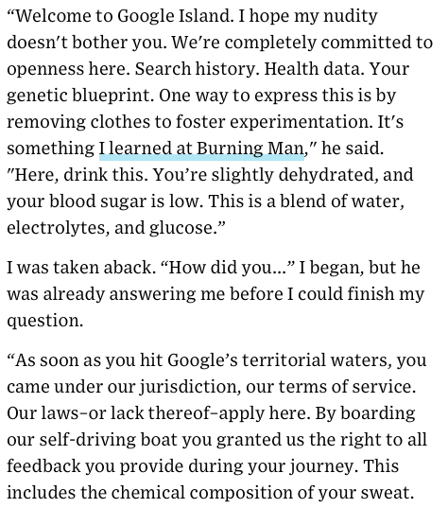
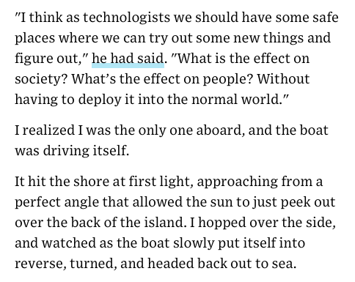
Mat Honan, Welcome to Google Island, Wired 5/7/2013

Slide 21
VSD: Key concepts
Values are not just addressed at the user interface level, often affect the entire system
Many interesting interactions relate to tensions between values

Slide 22
Values: not just a UI problem
Often, fundamental characteristics of how a system is engineered affects values
Examples: end-to-end encryption in chat, privacy preserving algorithms
Apple Maps privacy statement: “Maps is also engineered to separate the data about your trips — including public transit directions — into segments, to keep Apple or anyone else from putting together a complete picture of your travels. Helping you get from Point A to Point B matters a great deal to us, but knowing the history of all your Point A’s and Point B’s doesn’t”
Notes:
Other examples?

Slide 23
Value tensions
Many of the challenges we encounter in addressing values relates to trade-offs between values
Usability vs. security - e.g. two-factor authentication
Privacy vs. accountability - e.g. Twitter vs. Facebook’s “real names” policy

Slide 24
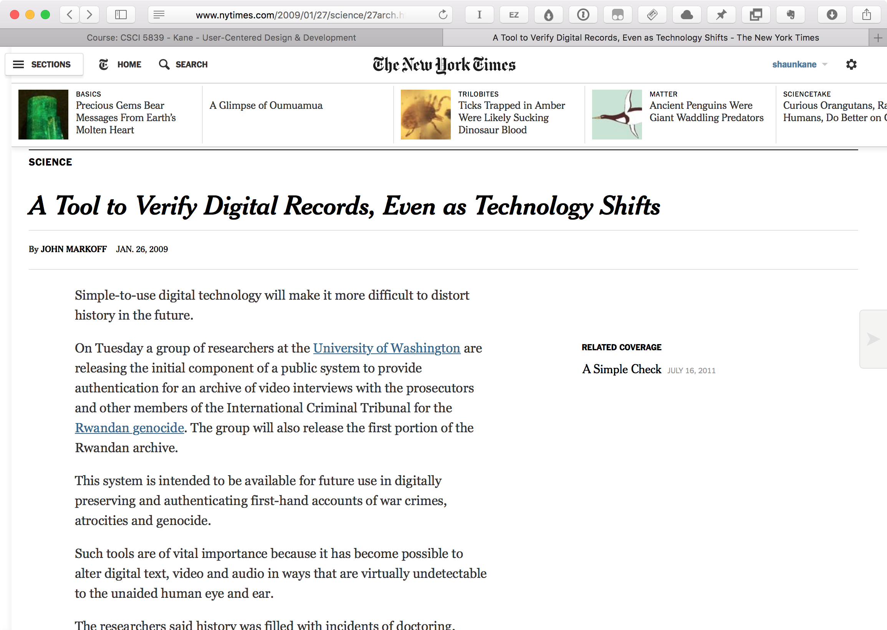
Notes:
NYTimes article: http://www.nytimes.com/2009/01/27/science/27arch.html
One research paper to start with on this project: http://www.vsdesign.org/publications/pdf/p2527-yoo.pdf

Slide 25
Values in design mini-activity
Let’s catch some values in current technology
See doc at shaun.cat/values

Slide 26
Values in design

Slide 27
What to do with this?
Understand how features & characteristics of a system can affect its impact on people
“This app is creepy.” → can choose to use or ignore
“This app affects users’ sense of privacy because it...” → can suggest concrete changes, develop alternatives

Slide 28
Wrapping up

Slide 29
Class is over!
So what do we have to show for it?

Slide 30
End goals (from day 1)
Gain expertise in applying methods of user centered design
What’s it good for?
Make things that work better for people
Understand why things are bad and how to fix them
Create new things that meet what users want and need

Slide 31
Topics covered
User-centered design process
Sketching, storyboarding, prototyping methods
Usability standards
Usability assessment methods - user tests, heuristic evaluation
Visual design for UIs
Qualitative research methods - interviews, questionnaires
(intro) analysis of usability study data
Models of human performance
Methods for designing and evaluating gestures
Representing data visually
Representing data non-visually
Designing for collaborative use
Considering broader impacts and human values
… many starting points with opportunities to explore further

Slide 32
Practice
Really the only way to get good at any of this stuff is through practice
Keep developing skills
Generating ideas
Sketching ideas and interactions
Observing how people do stuff and how it could be improved (to learn requirements)
Knowing how to ask the right questions (and what to do with answers)
Creating prototypes and understanding the feedback you receive
Be prepared for the situations you haven’t seen before

Slide 33
Takeaways / opinions
Why people use tools the way that they do is usually for reasons
It’s worthwhile to pay attention, ask questions, try things out in a thoughtful way
UI design is often about framing what people can do, are supported to do, and what is important
Opportunity to change what people do and how they work
Further reading: Bret Victor, What Can a Technologist Do About Climate Change?

Slide 34
Inclusion
One of the easiest, most significant ways to have impact as a designer/coder is by ensuring that people are included
Considering underrepresented or ignored groups
Considering indirect stakeholders
Designing to support a range of abilities → learn platform’s accessibility standards; for the web, start with WebAIM

Slide 35
Next steps
Classes from CSCI, ATLAS, Info Science on Human-Centered Computing track
And complementary courses in visual design, social sciences, statistics
Learn more about human-computer interaction / human-centered computing research (including research at CU)
Use what you know to make things around you better

Slide 36
Thanks, everybody!

Slide 37
FCQs
Please fill out FCQs for this class (and other classes)
https://colorado.campuslabs.com/courseeval

